Slide 1


Getting to The Starting Line Predicting NCAA National Qualifiers
Karis Jochen
TAMU Data Analytics Class of 2021

Slide 2

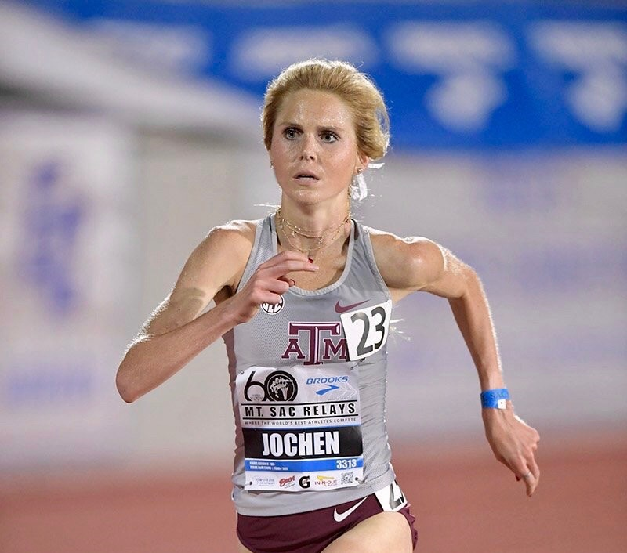

Member Texas A&M Track &Field
2013-2018
Goal: Qualify for Nationals
First Qualify for Regionals
Each Regional meet comprised of top 48
Top 12 at each Regional meet advance to Nationals
Pattern: Regional Qualifiers came from the same meets
4 out of my 5 years, Coach took athletes to California to try and qualify for Regionals
Year Aggies did not go to California, 50% less qualified
Note Meet Name

Slide 3
Executive Summary
NCAA Track & Field coaching salaries are tied to athlete performance. Coaches try to maximize the number of athletes qualifying for Nationals.
Goal: Help coaches identify athletes most likely to qualify for Nationals in the 5k.
Hypothesis: We can predict the athletes most likely to qualify for Nationals by focusing on a combination of athlete and race specific factors.

Slide 4
Business Problem
Getting to the Starting Line

Slide 5
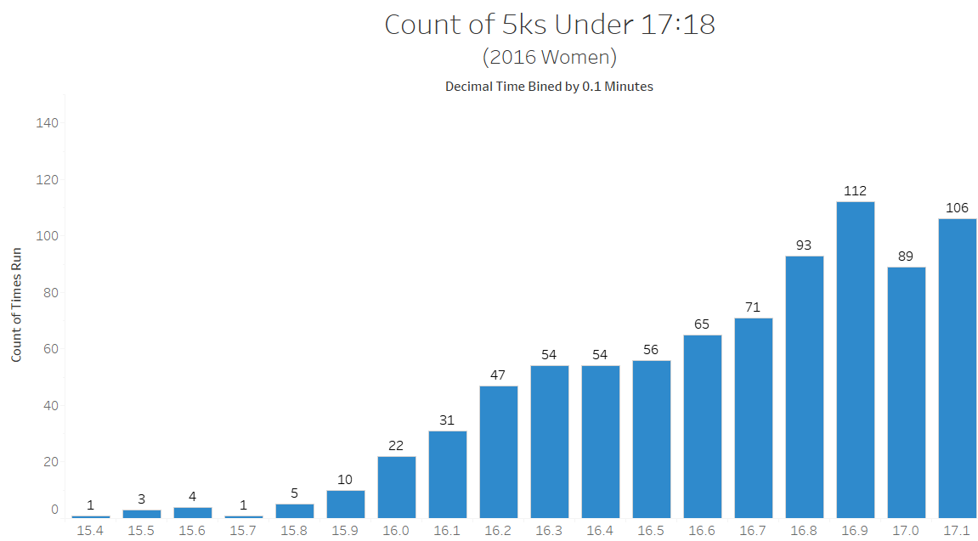
Fastest Runners Distribution
Business Question: Do the fastest runners qualify for Nationals?
Analysis: 5,158 women ran 5ks in 2016
Observations:
24 5k times were faster than the winning time at Nationals
~718 5k times were faster than last place runner at Nationals
Road to Nationals more nuanced than simply “running fast”
Nationals Last Place:
17.08 minutes (17:04)
Nationals Champion:
15.95 minutes (15:57)

Slide 6
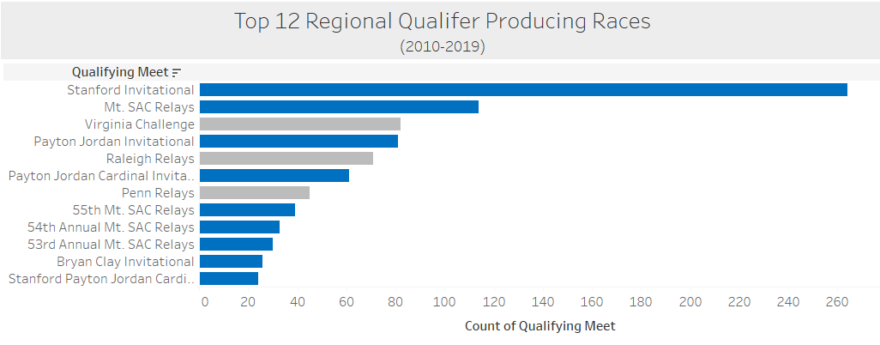
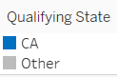
Regional Qualifying Race Distribution
Business Question: Where is the “best” location to qualify for Regionals?
Analysis: Most common qualifying races over the past 9 years
Observations:
9 of the top 12 locations in CA
836 (51%) of 1,633 runners qualified in California
Suggests a California effect to qualifying for Regionals

Slide 7
Data
Getting to the Starting Line

Slide 8

Process
Data Acquisition
Source Data: TFRRS, Coach’s Salaries
Data Cleansing
Identify duplicate, incomplete data & outliers
Data Acquisition and Visualization
Visualize regional times, races, athletes
Transform Data
Create and Analyze Models
Create new variables: internal athlete factors, external race factors
Conclusions
Balance predictability with usability
Improve and expand current model

Slide 9
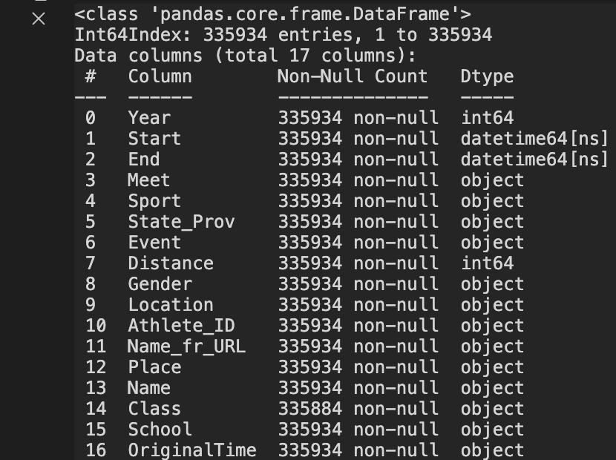
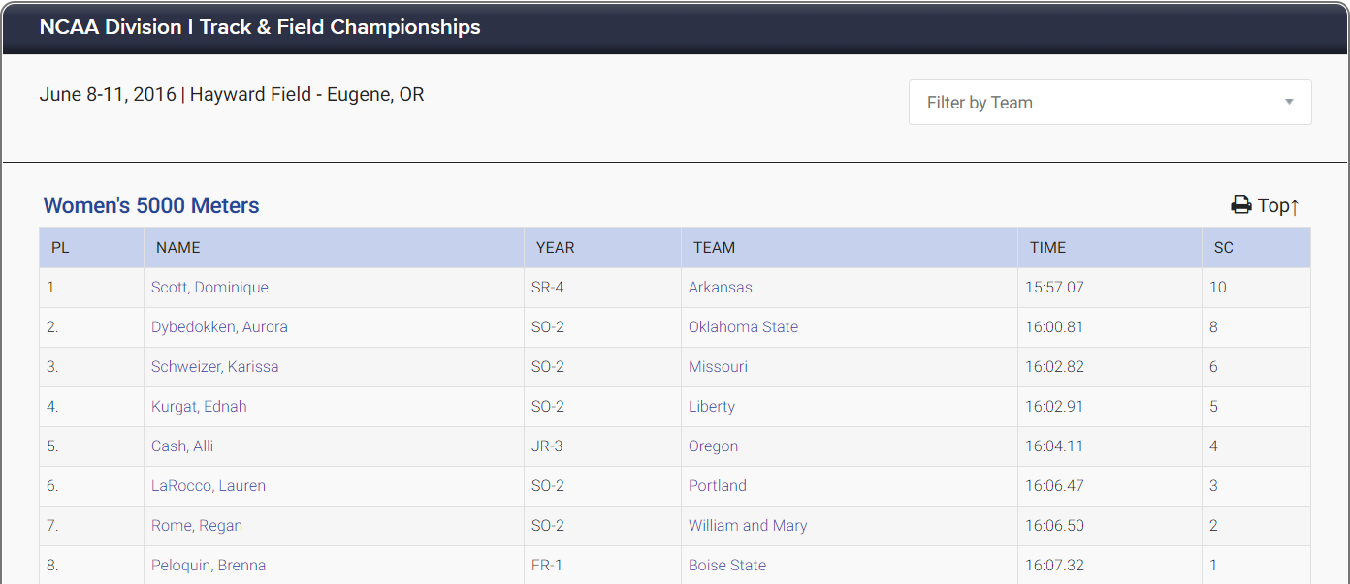

Build a Database
Scrape data
335,934 entries:
263,320 5ks, 72,614 10ks
188,529 Men’s, 147,405 Women’s
Track & Field Results Reporting System

Slide 10
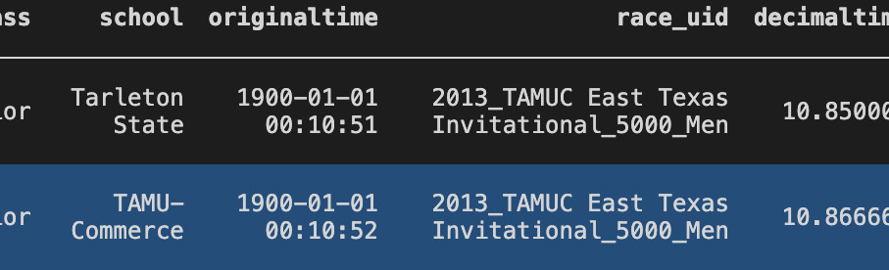
Data Cleaning
Limit to 5k only, <24 min = 335,934 entries
Extract important features: year and state
Transform original time to decimal time: e.g., original time= 16:30 min., decimal time = 16.50 min.
Remove duplicates and inconsistencies: create unique race and athlete UIDs
Identify and eliminate bad data
Python output: example of bad data identifying erroneous “World Record” Times

Slide 11
Transform Data: Athlete Specific Features
Business Question: How do we identify athletes most likely to qualify for Regionals?
Exploratory Analysis: Create Athlete Specific Features
Experience
Number of races
Talent
Personal Record
Fitness
Days since PR
Days since last race
Average race time
Days since Last Race
Season PR
Season’s Average of all Races

Slide 12
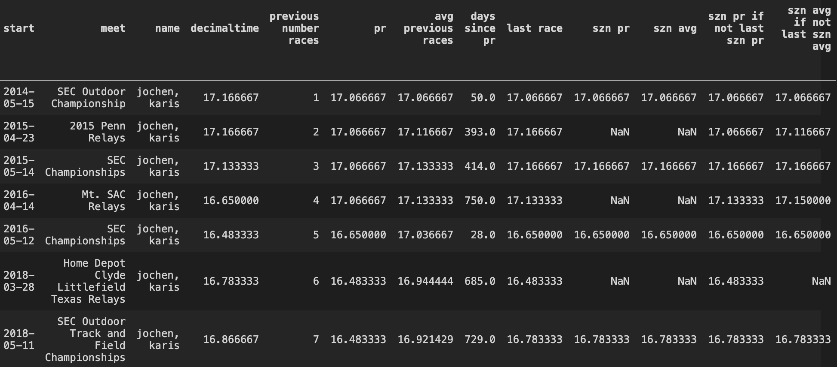
Athlete Specific Features
Experience
Talent
Current Fitness

Slide 13
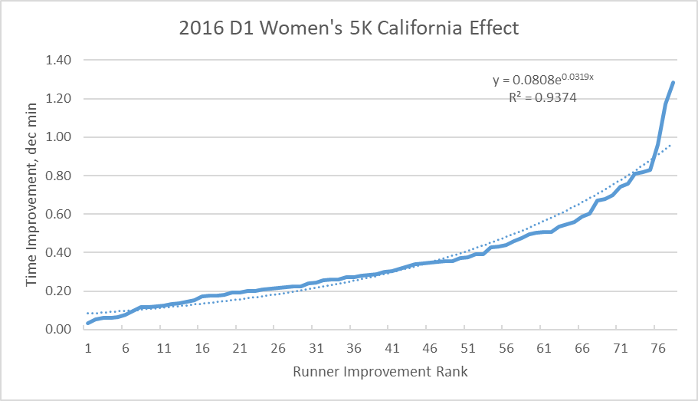
Race Specific Features
Business Question: What is the impact of the race location?
Exploratory Analysis:
Visualize the improvement on performance for female runners who ran a 5k in CA in 2016
Observations:
The 48th fastest runner ran 23 sec. faster in CA
~80th fastest runner ran ~1 minute faster in CA
Reinforces strength of the California Effect
2016: Quantifying the California Effect

Slide 14
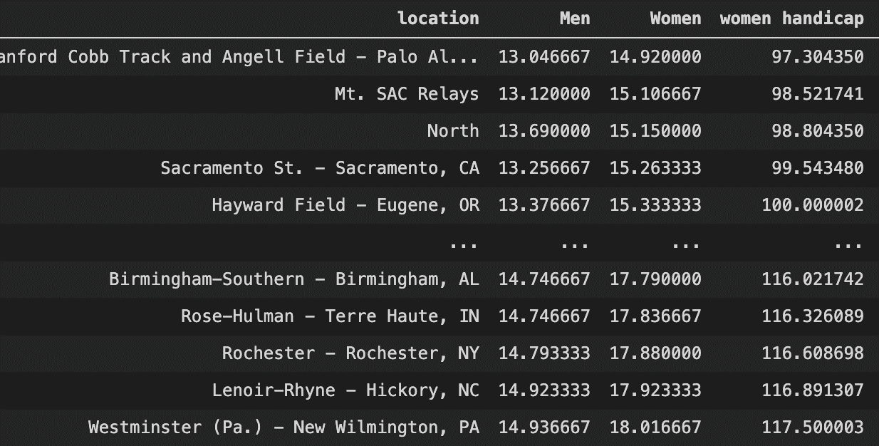
Transform Data: Hayward Handicap
Business Question: Can we compare times between different race locations?
Horse Racetracks & Golf Course Handicaps
Capture the impact of location, weather, track
Need a baseline → Hayward Field
Exploratory Analysis: Hayward Handicap
105 locations - 99 most popular tracks + 6 geographical regions
Compared average of each location’s top 5 men’s & women’s times
Coaches can use knowledge to build race schedules and compare times across locations

Slide 15
People
Getting to the Starting Line

Slide 16

Dream Team!!
Runners and coaches dreaming a dream and trying to beat the odds!!!
Race Directors reporting results
TFRRS website host
Pablo Ormachea sharing his extensive knowledge of different ways to look at the same data and different modeling techniques
Jim Webb discouraging me from changing my capstone a 4th time, keeping me focused, and humoring my Taylor Swift side project

Slide 17
Models
Getting to the Starting Line

Slide 18
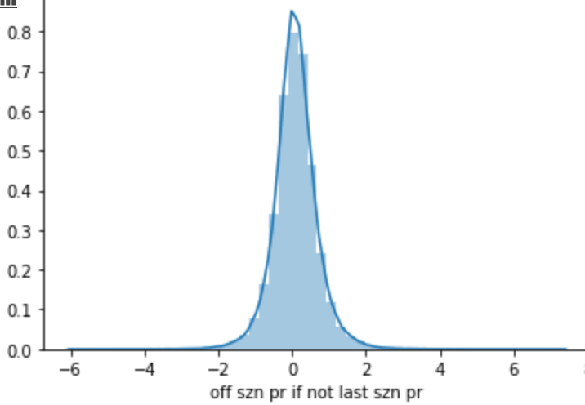
Sub-setting Data
Business Question: Does the data include races not relevant to our model?
Exploratory Analysis:
Created “szn pr offset” variable
“szn pr offset” = “decimal time” (time ran today) minus “szn pr”
Tactical Races: Run for a place rather than a time
(offset > 1.5, i.e., ran 90 sec. slower than PR):
Outdated Data: Runners are new or returning from injury
(offset < -1.5, i.e., ran 90 sec. faster than PR)
Outdated Data
Tactical Races
Distribution of “szn pr offset” variable

Slide 19
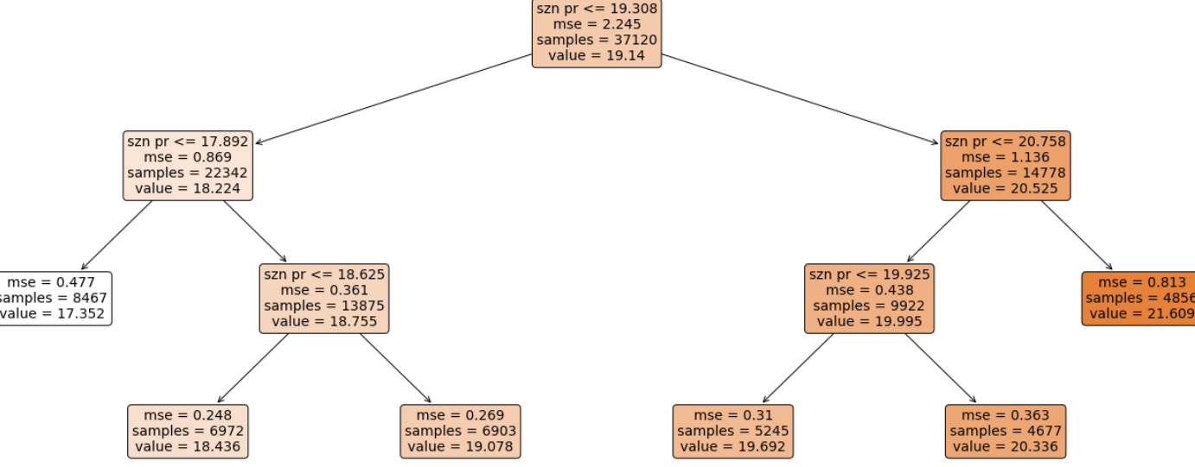
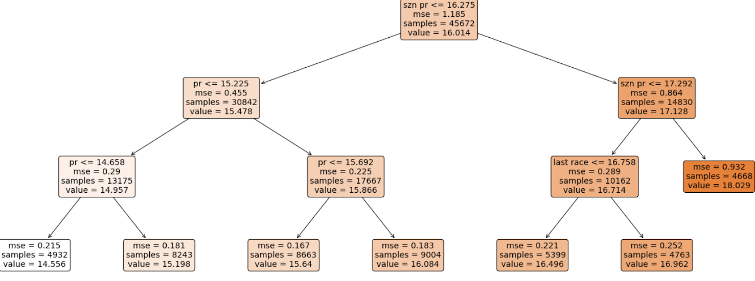
Complex Models for Simple Solution
Initial model had a gender dummy variable → split into 2 gender-specific models
92,271 men
72,779 women
Decision Tree Regressor model on each gender to find most significant split:
Men’s first split at “szn pr” <= 16.275 min
Women’s first split at ”szn pr” <= 19.308 min
Men’s Decision Tree
Women’s Decision Tree

Slide 20
Model Exploration
Variable Selection
92,271 men, 72,779 women → 4 groups
Fast Men: “szn pr” <= 16.275 min. (44,051); Slow Men: “szn pr” => 16.275 min. (48,220)
Fast Women: “szn pr <= 19.308 min.(31,755); Slow Women: “szn pr >= 19.308 min.(41,025)
Recursive Feature Elimination: all features & recursively remove least significant feature
Model Validation
Sci-kit Learn Train-Test Split -70% Training/30% Testing
Value Model Parsimony balanced with Model Predictive Power

Slide 21
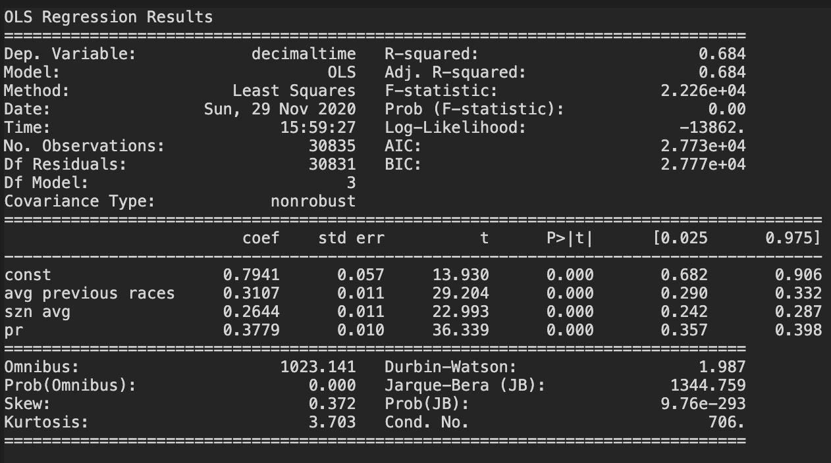
Fast Men
Recommended Model:
RFE Selection 3 variables:
‘pr’
‘avg previous races’
‘szn avg’
MAE: 0.296 (17.78 sec.)
R2 of 0.68
Athlete Specific Features Matter
* Slow Men’s Model included Appendix not relevant for study

Slide 22
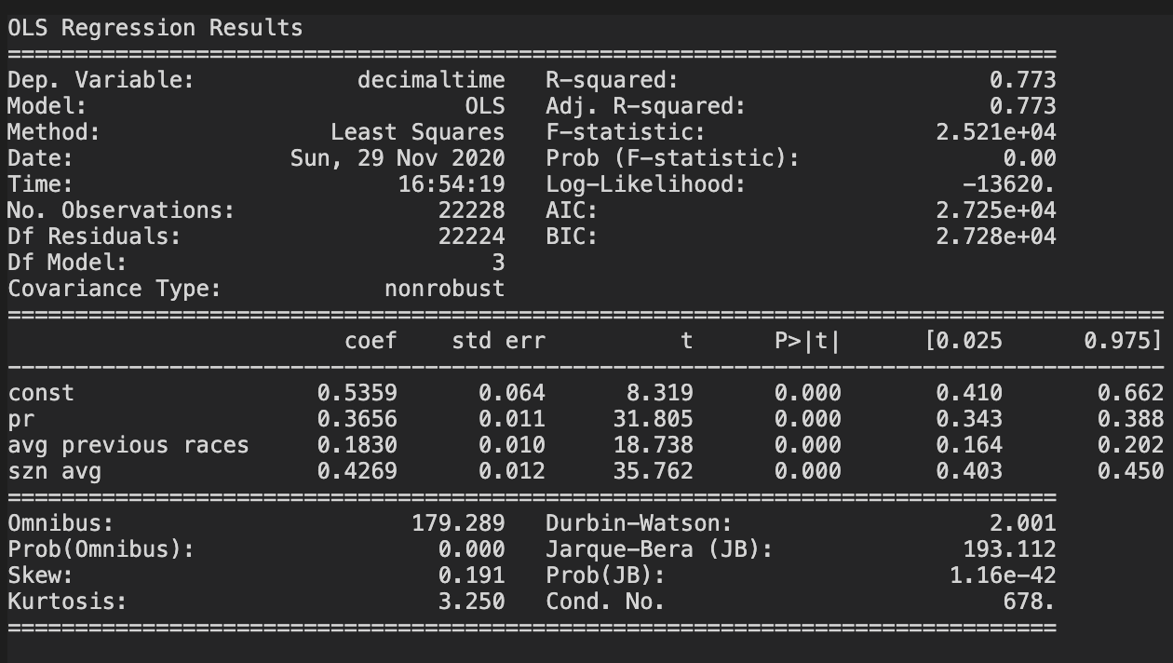
Fast Women
R2 vs. MAE:
RFE Selection 7 variables, better R2: 0.77, but worse MAE: 0.4370 (26.22 sec.)
More complicated
Recommended Model:
RFE Selection 3 variables:
‘pr’
‘avg previous races’
‘szn avg’
MAE of 0.344 (20.64 seconds), R2 of 0.76
Athlete Specific Features Matter
* Slow Women’s Model included Appendix not relevant for study

Slide 23
Model Application
Business Question: How does a Coach use the model to choose which athletes have the best chance of qualifying for Regionals?
Analysis: Develop an athlete standard
Observations:
Average Regional Qualifying Time for Women over the past 9 years was 16.51 minutes
5,000 women run 5K per year - 96 qualify for Regionals; trying to find that < 2%
East
West

Slide 24
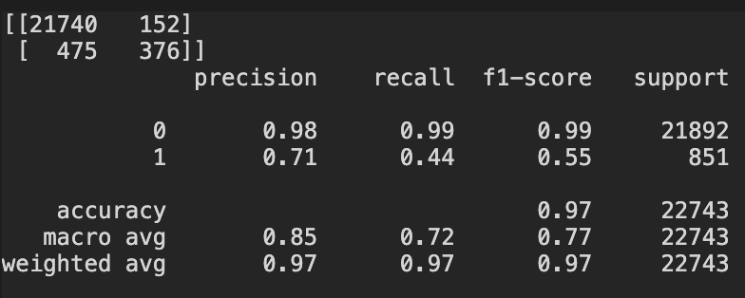
Satisfying the Business Question
Population of interest: Fast men and women predictive models strong
Calculated features useful to improve models for slow men or women
Men’s Average Regional Qualifying time 14.16 minutes past 9 years
Women’s Average Regional Qualifying time 16.51 minutes past 9 years
97% accuracy transforming into a classification problem (22,116 rows out of 22,743 predictions)
Primary Question: Given runner and race location, can we predict whether runner will qualify for the first round of Nationals?
Python Output: Confusion Matrix where 1=time ran < average regional qualifying time

Slide 25
Conclusions
Getting to the Starting Line

Slide 26
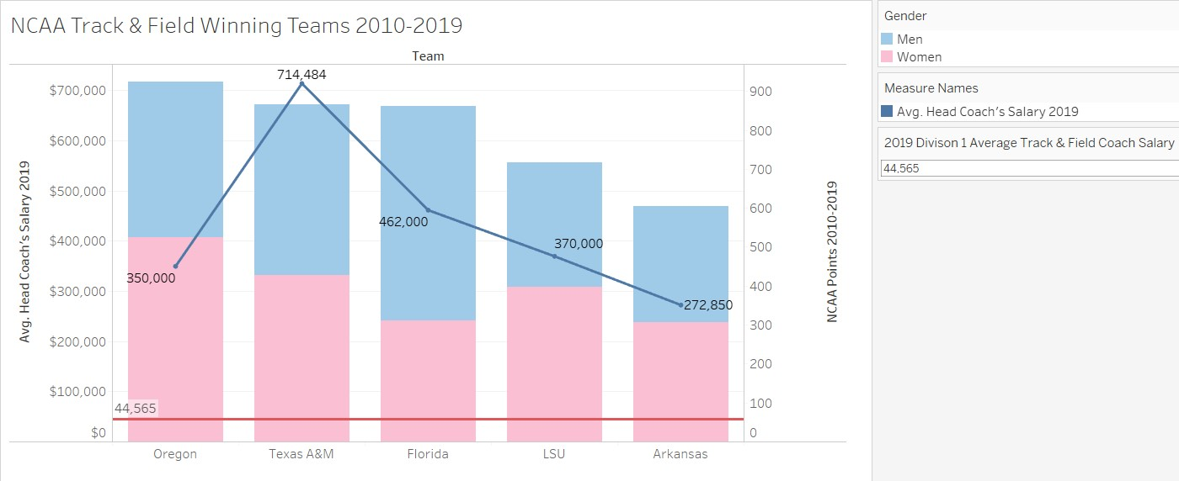
The Numbers Game
Coaches paid by succuss at National Championships
2019 Statistics
Number of Teams to “Score”
Men – 61
Women – 66
Ave. salary top 5 winning coaches $365,800
Ave. Head coach salary $44,565
$1,800 travel/athlete (I&O)
How can a coach maximize ROI?
Men
Women
Average Head Coach Salary

Slide 27

Conclusion
“Which athlete should I fly to California this year?”
Athlete Specific Features: experience, talent and fitness
Race Specific Features: “Hayward Handicap,” regional qualifying races, and the California Effect
“Is the athlete worth the cost?”
51% of the regional qualifying races are in California
Utilize budget: $1,000 - $1,800 travel/athlete (Indoor & Outdoor)
97% model accuracy in determining if an athlete is ready to qualify for Regionals

Slide 28
Impact
Getting to the Starting Line

Slide 29
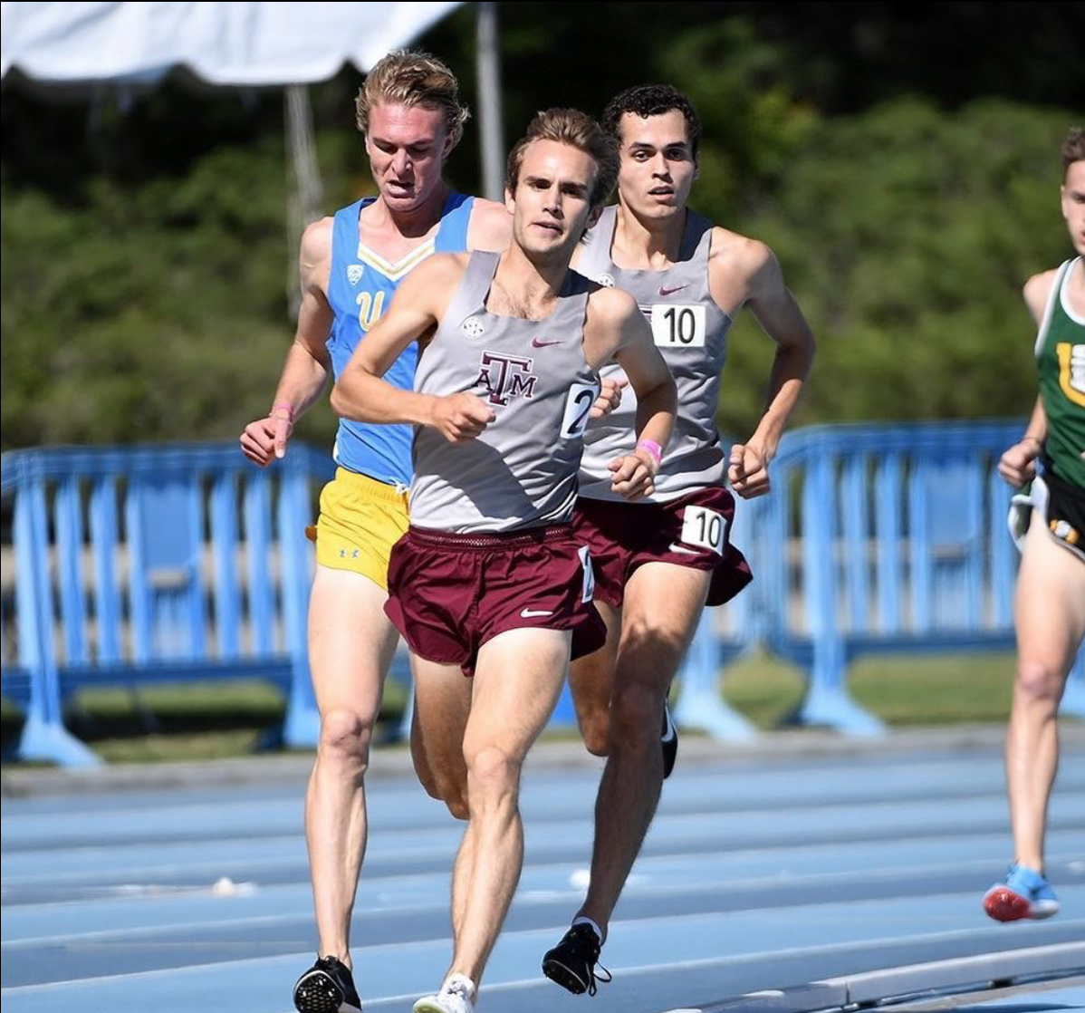
Impact
Parties of interest
NCAA Programs – documented differences in race location
Coaches – model to make decisions on athlete’s likeliness to qualify
Athletes – understanding the importance of athlete and race specific features when trying to qualify for Nationals

Slide 30
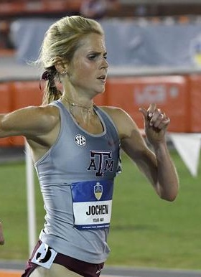
Impact
Build the most accurate, SIMPLE model that all coaches and athletes have access to and can communicate
Model provides another tool in a coach’s toolbox to help them make better decisions
Estimated Value: Increase coaching salary by maximizing ROI on athlete travel budget

Slide 31
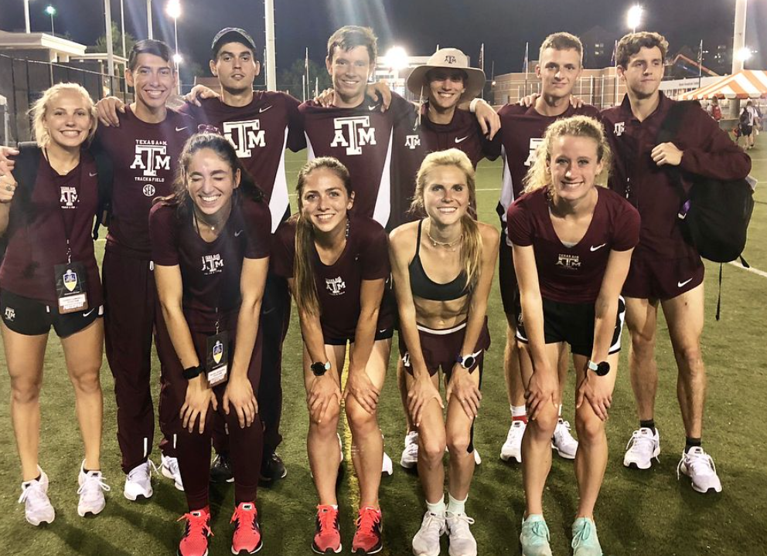
Impact
Programming Skills
Zero programming experience
Data Cleaning/Transformation
Imputation methods
Outside the box and computing new features
Exposure to New Models, Selection & Interpretation
New Goodness-of-Fit Metrics
New skills enable a career change

